Slide 1

ME 165
Mechanical Engineering Fundamentals
Md. Aminul Islam
Lecturer
Department of Mechanical Engineering, BUET

Slide 2
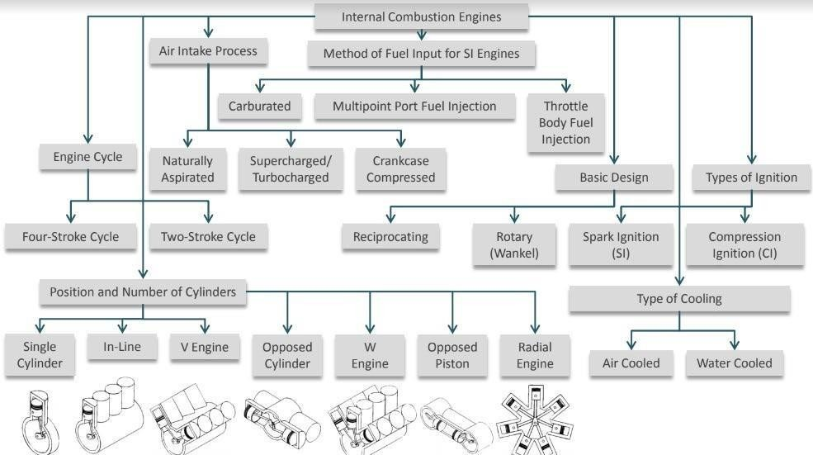
Engine Classification

Slide 3
Engine Classification
Method of Ignition
Spark ignition (SI): High-voltage electrical discharge between two electrodes ignites air-fuel mixture in combustion chamber surrounding spark plug. Example: Petrol Engine
Compression ignition (CI): Air-fuel mixture self-ignites due to high temperature in combustion chamber caused by high compression. Example: Diesel engine
Number of strokes per cycle
Four-stroke: Four piston movements over two engine revolutions for each engine cycle.
Two-stroke: Two piston movements over one revolution for each engine cycle.

Slide 4
Engine Classification
The type of fuel
Gasoline, Diesel or fuel oil, Gas (natural gas or methane), Liquefied petroleum gas (LPG): mainly propane, propylene, butane, and butylene
Alcohol (ethyl, methyl), Dual fuel (e.g. methane/diesel), Gasohol (e.g. 90% gasoline, 10% alcohol)compression.
Biodiesel: cleaner-burning diesel fuel made from natural, renewable sources such as vegetable oils.
The cycle of operation
Otto cycle (also known as constant volume cycle) engine
Diesel cycle (also known as constant pressure cycle) engines
Dual combustion cycle (also known as semi-diesel cycle) engines

Slide 5
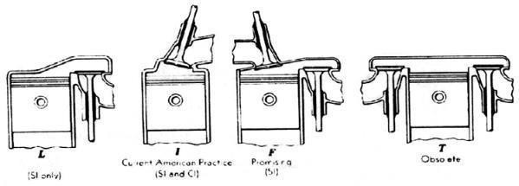
Engine Classification
Valve location
Valves in head
Valves in block
One valve in head and one in block (less common)

Slide 6
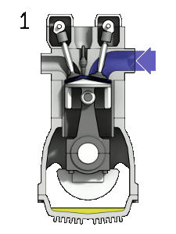
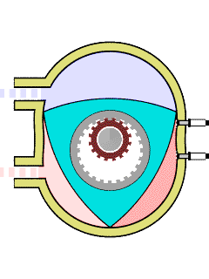
Engine Classification
Design
Reciprocating
Rotary
Number of cylinders
Single cylinder engines (e.g. lawnmowers),
Multi-cylinder engines.
The cooling system
Air cooled engine, (b) Water cooled engine,
(c) Evaporative cooling engines

Slide 7
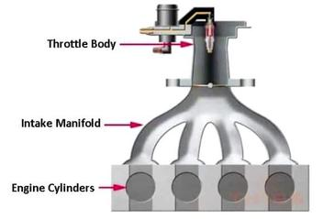
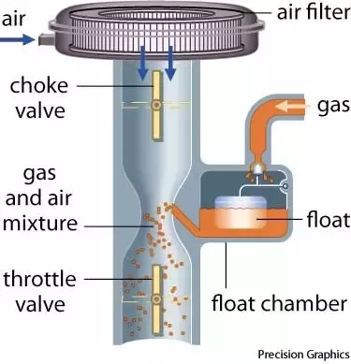
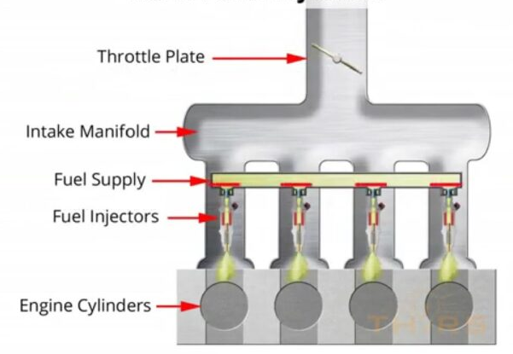
Engine Classification
Method of Fuel Injection
Carburetor
Throttle body Fuel Injection
Multi port Fuel Injection

Slide 8
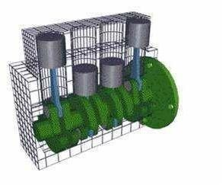
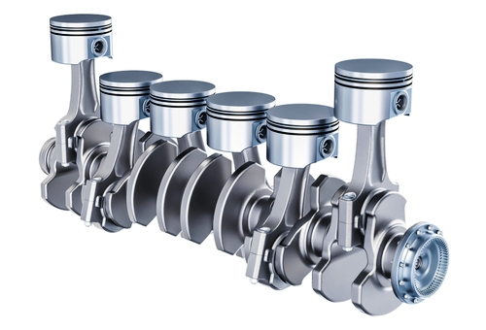
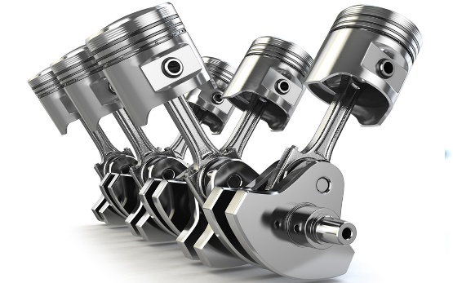
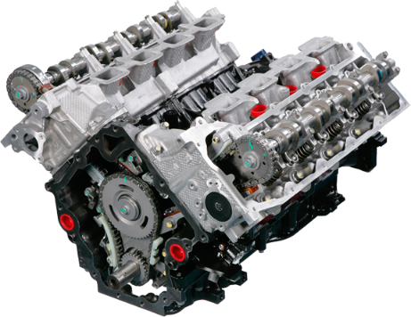
Engine Classification
Arrangement of cylinders:
In-line or straight: cylinders in straight line, one behind the other in length of crankshaft.
V:
two banks of cylinders at an angle with each other along a single crankshaft, angle typically 60-90⁰

Slide 9
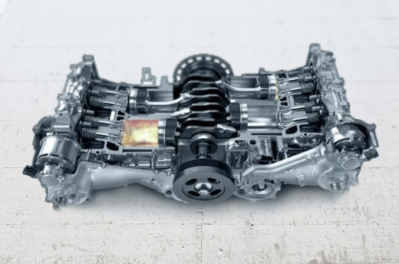
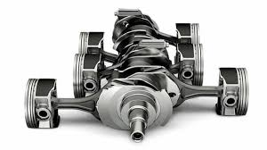
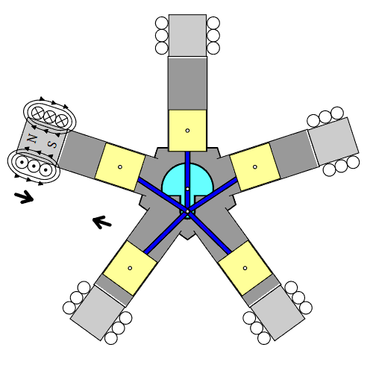
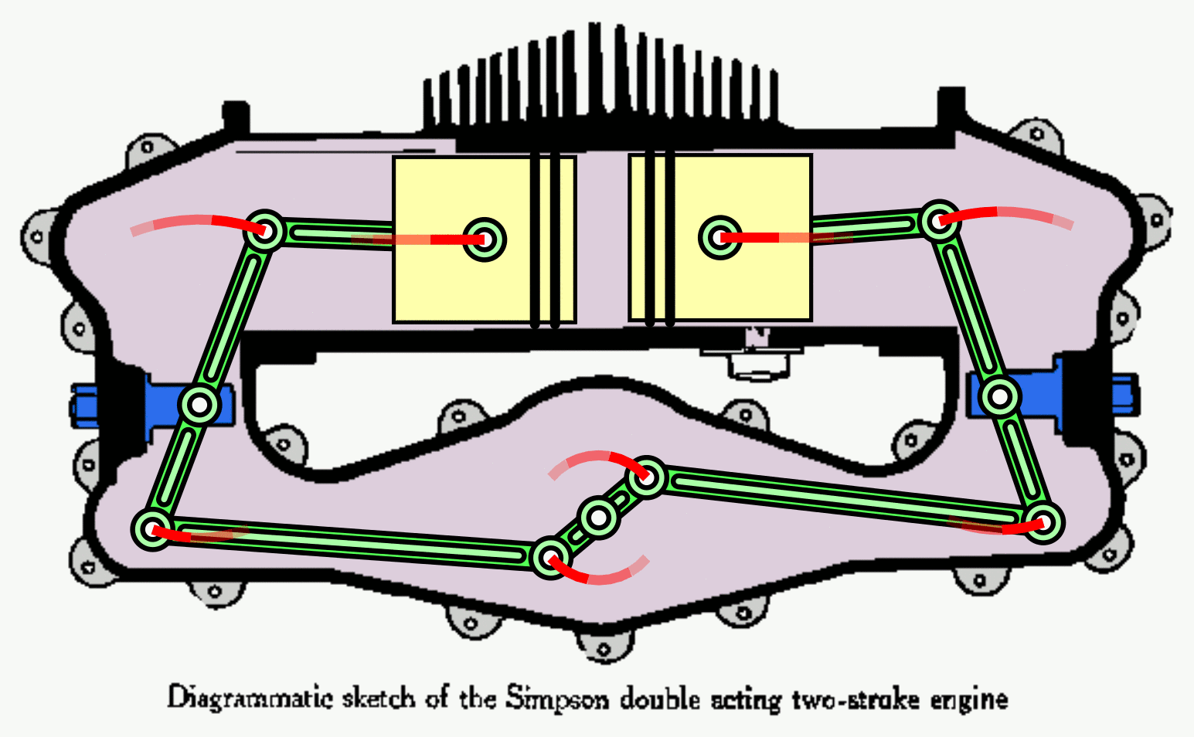
Engine Classification
Arrangement of cylinders:
Flat or opposed cylinder (V with 180⁰):
two banks of cylinders opposite each other on a single crankshaft (smallaircrafts)
Opposed piston engine:
two pistons in each cylinder, combustion chamber between pistons
Radial engine:
cylinders positioned radially around crankshaft.

Slide 10
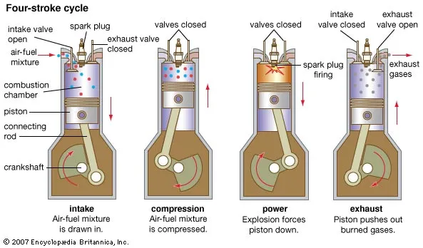
4 stroke SI (Petrol) engine operation

Slide 11

4 stroke CI (Diesel) engine operation
https://www.youtube.com/watch?v=fTAUq6G9apg&t=39s
https://www.youtube.com/watch?v=fTAUq6G9apg&t=39s

Slide 12
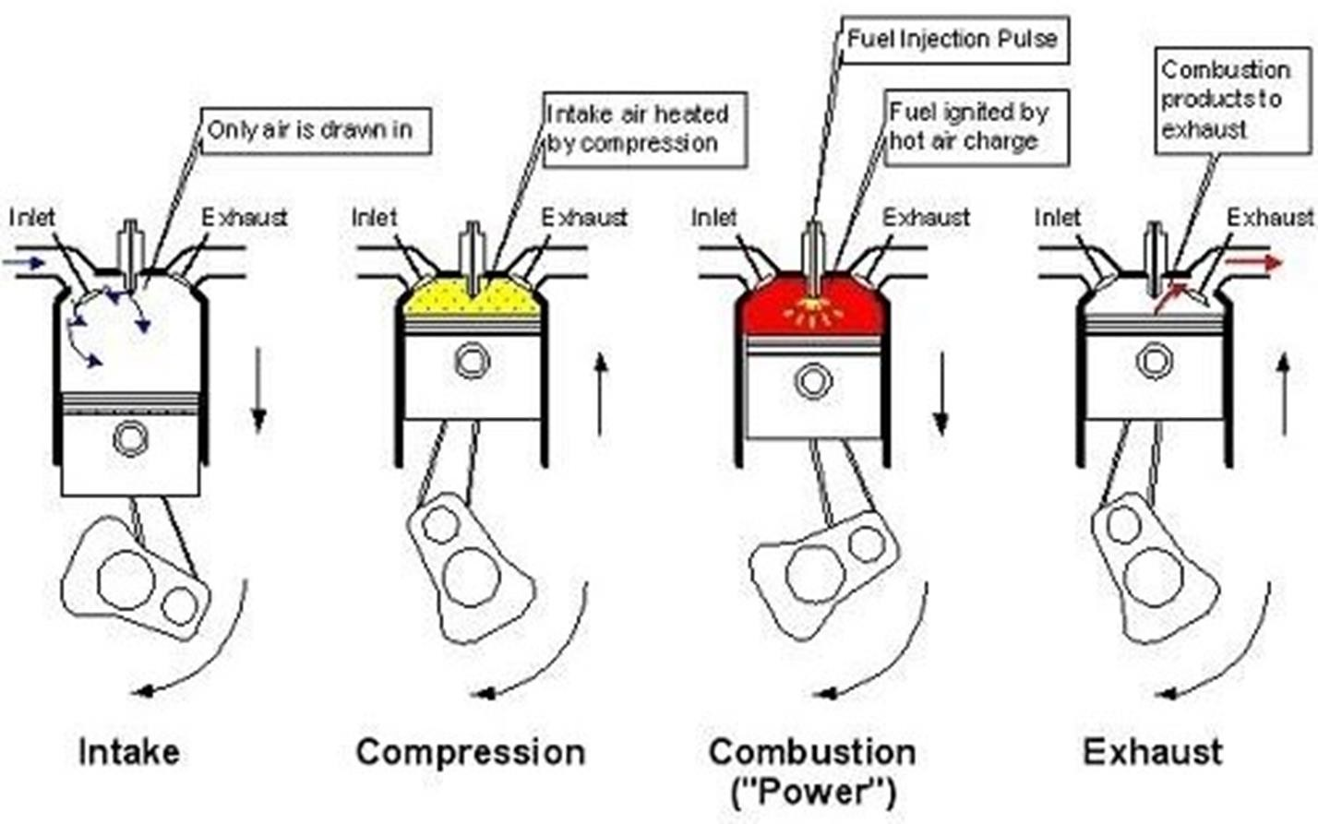
4 stroke CI (Diesel) engine operation

Slide 13
SI vs CI
What are the differences between Petrol and Diesel Engine??
Ignition system
Compression and pressure
Compression ratio
Size of the engine
https://www.youtube.com/watch?v=fTAUq6G9apg&t=39s

Slide 14
SI vs CI
SI Engine
CI Engine
Draws a mixture of air and fuel during intake
Carburetor is used to mix air and fuel
Pressure at the end of compression stroke around 10 bar
Spark ignites the air fuel mixture
Compression ratio varies from 6 to 10
Starting easier due to lower compression ratio
Engines are lighter and cheaper due to lower compression ratio
Maintenance cost low
Thermal efficiency lower (around 26%)
Higher engine speed
Used in light vehicles such as cars, motorcycles etc.
Draws only fuel during intake
Injector or atomizer is used to inject fuel
Pressure at the end of compression stroke around 35 bar
The fuel self-ignites
Compression ratio varies from 15 to 25
Starting difficult due to higher compression ratio
Engines are heavier and costlier due to higher compression ratio
Maintenance cost higher
Higher thermal efficiency (40%)
Engines are typically slow moving
Used in heavy duty vehicles such as buses, trucks etc.
https://www.youtube.com/watch?v=fTAUq6G9apg&t=39s

Slide 15
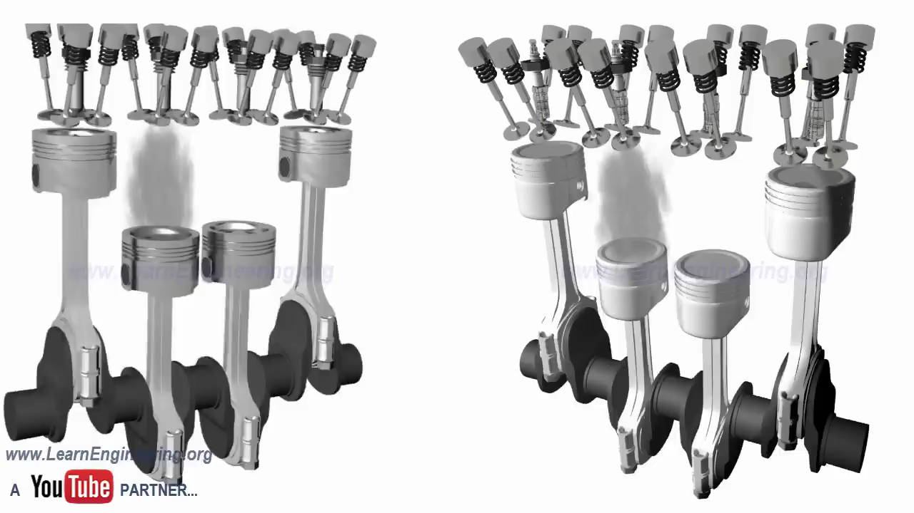
SI vs CI
https://www.youtube.com/watch?v=bZUoLo5t7kg
https://www.youtube.com/watch?v=fTAUq6G9apg&t=39s

Slide 16
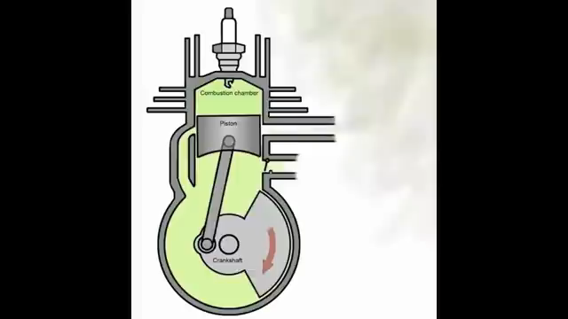
2-stroke SI (Petrol) engine operation
https://www.youtube.com/watch?v=xNLE8G3pC0k

Slide 17
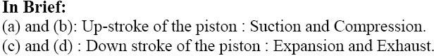
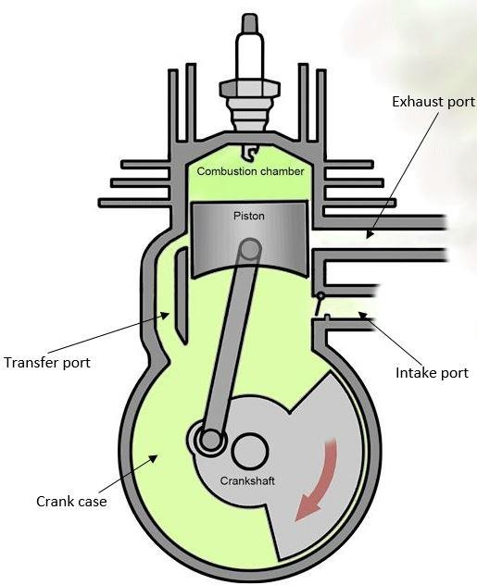
2-stroke SI (Petrol) engine operation

Slide 18
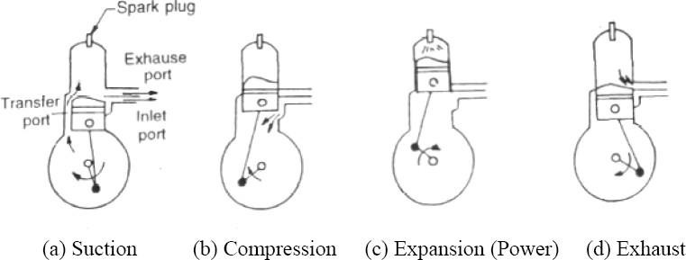
2-stroke SI (Petrol) engine operation

Slide 19
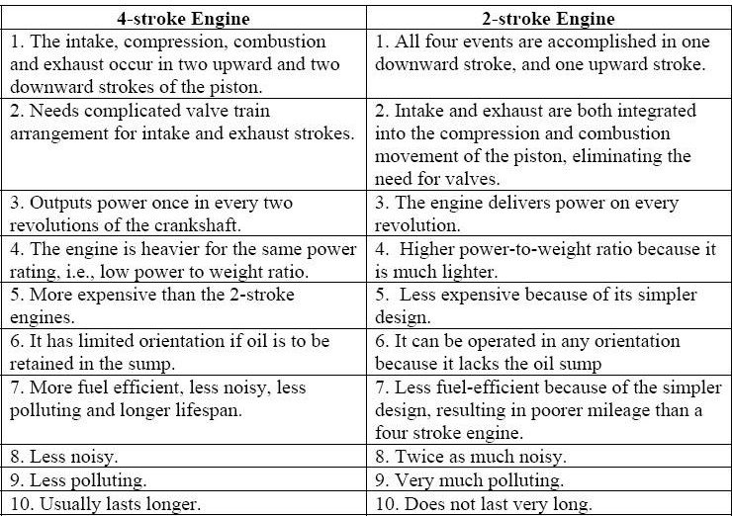
Comparison of 2-stroke and 4-stroke Engines

Slide 20
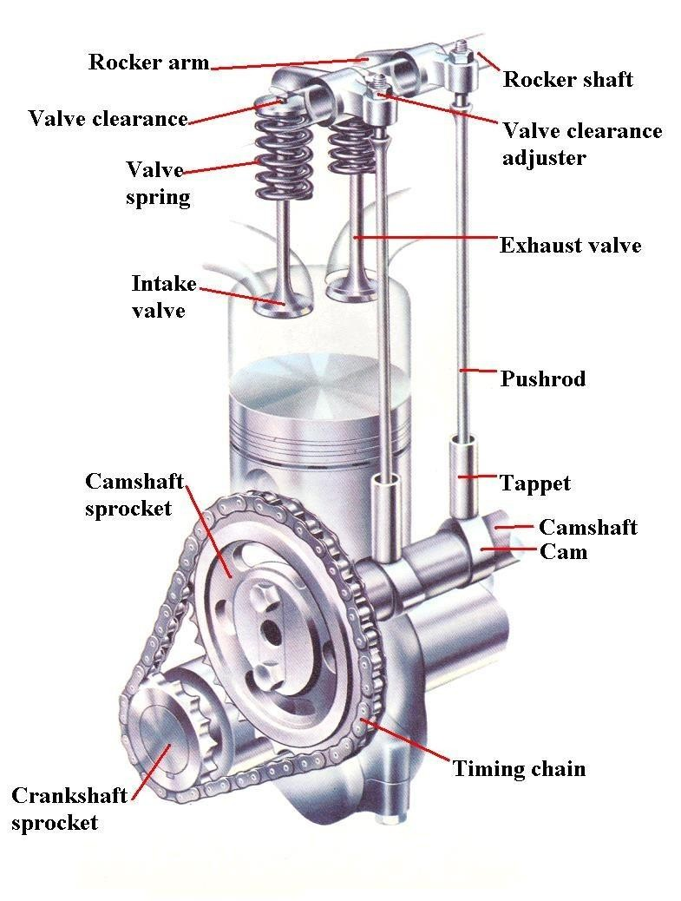
IC Engine: Cam and Camshaft
Cam: Mechanical component used to convert rotary motion into reciprocating motion
Cams are fitted in a camshaft
Camshaft is driven by crankshaft by chain-sprockets
or timing gears
1 cam required for each valve
Camshafts rotate at half the speed of the
crankshaft
Total engine rotation: 720°
IVO : 0°to 180°
EVO: 540°to 720°

Slide 21
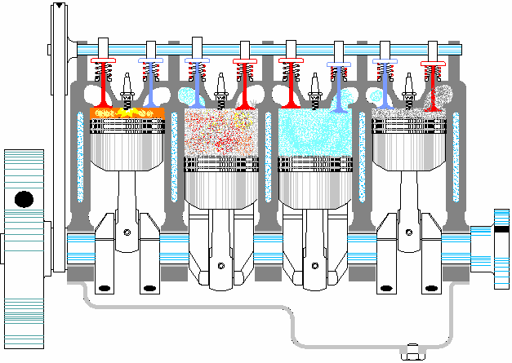
IC Engine: Firing Order
Firing order: Inline four cylinder 1-4-3-2
Firing order in a multi-cylinder engine is arranged so that the torsional moment is even and the load is uniformly distributed on longitudinal direction of the crankshaft. An even firing order will increase the balance of engine. Successive combustion in the cylinders that standing side by side should be avoided so that the force transmitted to the crankshaft does not become one-sided.

Slide 22

Problem 1
A six-cylinder two-stroke engine with a compression ratio r = 9 produces a torque of 1100 Nm at a speed of 2100 rpm. It has a bore b of 123 mm and a stroke s of 127 mm.
What is the displacement volume and the clearance volume of a cylinder?
mean piston speed
Solution:
V_{d} = (π/4) * b² * L
We know that r = (V_{d} + V_{c})/ V_{c}
U_{p} = 2NL/60

Slide 23
Problem 1
A six-cylinder two-stroke engine with a compression ratio r = 9 produces a torque of 1100 Nm at a speed of 2100 rpm. It has a bore b of 123 mm and a stroke s of 127 mm.
What is the displacement volume and the clearance volume of a cylinder?
mean piston speed
Solution:
V_{d} = (π/4) * b² * L
= 1.51 × 10⁻³m³
We know that r = (V_{d} + V_{c})/ V_{c}
The clearance volume, V_{c} = V_{d} /(r −1)
= 1.89 × 10⁻⁴ m³
U_{p} = 2NL/60 = 2 * (2100/60) * 0.127 =8.89 m/s

Slide 24
Problem 2
A three-liter SI V6 engine that operates on a four-stroke cycle at 3600 RPM. The compression ratio is 9.5, length of the connecting rods is 16.6 cm, the engine is square (B=L) Calculate:
Cylinder bore
Stroke length
Average piston speed
Clearance volume of one cylinder
Solution:a. Given, Swept volume, Vs=3×10⁻³m3 RPM of engine, N = 3600
The engine bore, B=? Stroke length, L =?
We know, V_{s}= n×(𝜋/4×B²×L )
(here n is no. of cylinder)/

Slide 25
Problem 2
Since B = L, so L = 0.086 m
Average piston speed Sp =?
We know, Sp = 2NL
= 2×3600×0.086 m
= 2×(3600/60)×0.086 m
= 10.32 m/s
Clearance volume of one cylinder: the clearance volume for one cylinder, We know that r = (V_{d} + V_{c})/ V_{c}
The clearance volume, V_{c} = V_{d} /(r −1)= 352.941 cm³
V_{C} = 352.941/6 cm³ = 58.82 cm³ ≈ 59 cm³

Slide 26
Acknowledgement
Slide Courtesy:
Dr. Aman Uddin, Assistant Professor, Department of Mechanical Engineering, BUET
Saif Al-Afsan Shamim, Assistant Professor, Department of Mechanical Engineering, BUET

